Slide 1
Why and How We Write

Slide 2

Source and Inspiration

Slide 3


Why Write
Why Do Your Write
https://forms.office.com/r/eQRyAS51LL

Slide 4
Listen to other people’s advice, but that doesn’t mean you should follow it
Janet Currie, Princeton University

Slide 5
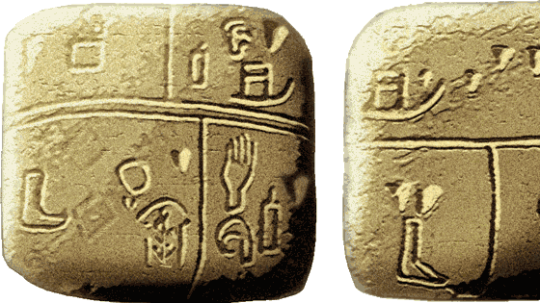
Why Write?
The Kish tablet from Sumer, with pictographic writing. This may be the earliest known writing, 3500 BCE. Ashmolean Museum

Slide 6
Why Write?
A means of rendering language into a form that can be reconstructed by other humans separated by time and/or space.
Wikipedia
“The rule is simple: if you don’t write it down, it never happened.”
Michael Lopp

Slide 7

WRITE!
Etsy - Researchgotmelike

Slide 8
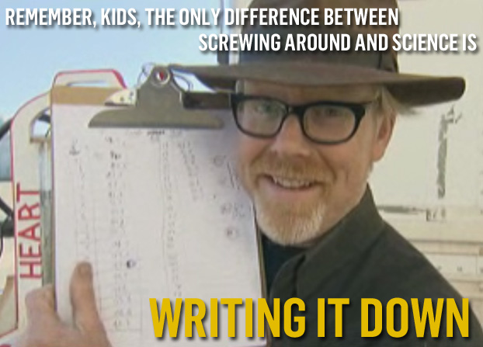

Slide 9
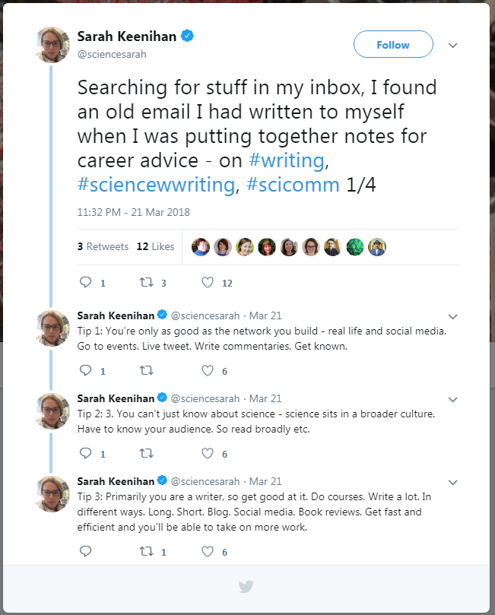
Primarily you are a writer, so get good at it.
Sarah Keenihan Twitter @sciencesarah

Slide 10
Publications ARE the Currency in Academics like Profits are in business.
Heather Talbott

Slide 11
Graduate School Writing
Thesis/Dissertation
Grants/Scholarships
Publications/Paper/Journal Article
Biographies/Personal Statements
Teaching materials
Progress reports

Slide 12
How We Write
???
??
?

Slide 13
Writing BASE
Behavioral Habits
Time, Space, and Habits for Writing
Artisanal Habits
Writing is a Creative Activity Requiring Learning, Development, and Skill
Social Habits
Writing For, With, and Among Others
Emotional Habits
The Role of Pleasure, Challenge, and Growth in Writing
Notes:
https://www.google.com/books/edition/Air_Light_Time_Space/SD9YDgAAQBAJ?hl=en&gbpv=0

Slide 14


Writing BASE
The Writing BASE
https://writersdiet.com/base/base/

Slide 15

How Do You Write
How Do You Write
https://forms.office.com/r/P2hUDRP1ws

Slide 16
Emotional Habits

Slide 17
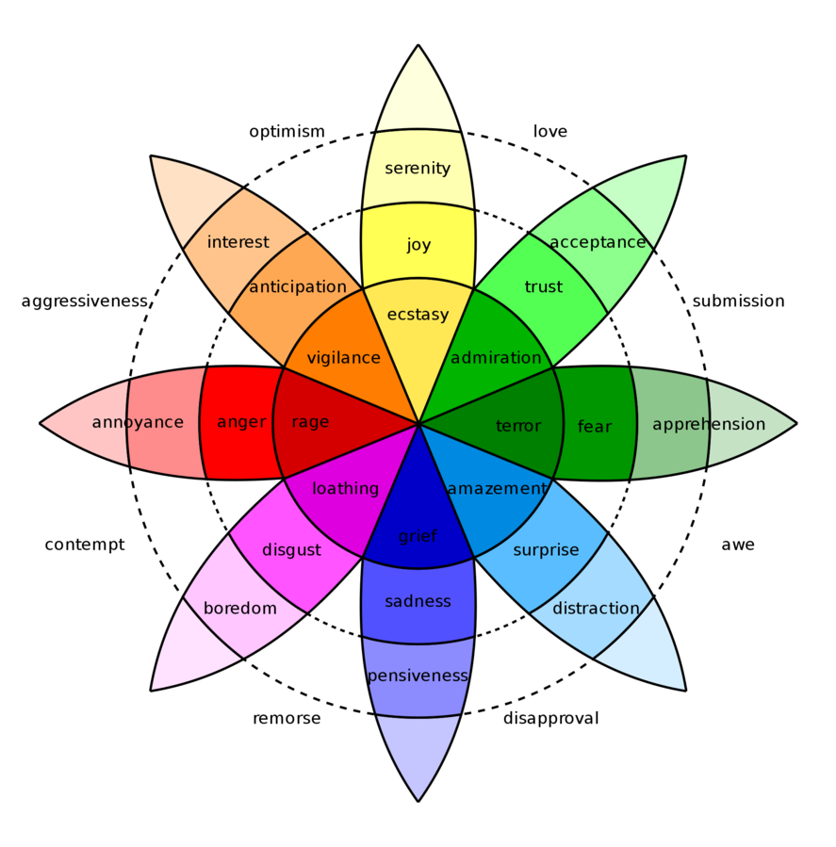

Emotional Writing
Pleasure
Challenge
Growth
Notes:
https://commons.wikimedia.org/wiki/File:Plutchik_Emotions.png

Slide 18
In the long run, the road to productivity will be a long and tedious one unless you can find meaningful ways to pave it with pleasure.
Helen Sword, author of Air & Light & Time & Space: How Successful Academics Write

Slide 19
What aspects of writing give me most pleasure and what pleasurable activities can I integrate to support my productivity? [paraphrase]
Helen Sword, author of Air & Light & Time & Space: How Successful Academics Write

Slide 20
Behavioral Habits

Slide 21

Finding your Behavioral Habits
Finding your time(s)
Finding your place(s)
Finding your rhythms and rituals

Slide 22
Writing is an “infinitely postponable” activity.
Anthony Grafton, Princton University

Slide 23
The best time to write is any time you do.
Helen Sword, author of Air & Light & Time & Space: How Successful Academics Write

Slide 24
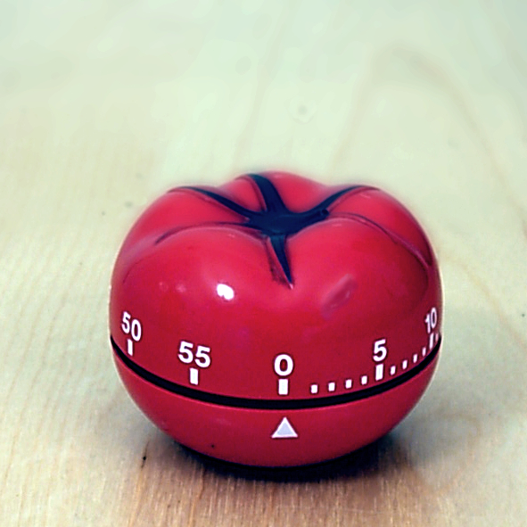

Timers
Pomodoro
Forest
Notes:
https://commons.wikimedia.org/wiki/File:Il_pomodoro.jpg

Slide 25
There is no “right” place for writing. The best place to write is anywhere you do.
Helen Sword, author of Air & Light & Time & Space: How Successful Academics Write

Slide 26
The best way to write is any way that works for you.
Helen Sword, author of Air & Light & Time & Space: How Successful Academics Write

Slide 27
Social Habits

Slide 28


For, With, and Among
Writing FOR others
Writing WITH others
Writing AMONG others
Notes:
https://pixabay.com/illustrations/social-media-connections-networking-5481633/

Slide 29
When we write for others, we engage in conversation with our readers. When we write with others, we work with colleagues toward a common product when we write among others, we create a community of writers.
Helen Sword, author of Air & Light & Time & Space: How Successful Academics Write

Slide 30
Artisanal Habits

Slide 31

Crafty Writing
Learning to write
The writing craft
Writing in other languages

Slide 32
To be a successful academic, it is not enough merely to have mastered the craft of writing intelligibly. You must also be creative enough to produce original research, …
Helen Sword, author of Air & Light & Time & Space: How Successful Academics Write

Slide 33
… persuasive enough to convey the significance of your findings to others, prolific enough to feed the tenure and promotion machine, …
Helen Sword, author of Air & Light & Time & Space: How Successful Academics Write

Slide 34
… confident enough to withstand the slings and arrows of peer review, strategic enough to pick your way safely through the treacherous terrain of academic politics, …
Helen Sword, author of Air & Light & Time & Space: How Successful Academics Write

Slide 35
… well organized enough to juggle multiple roles and commitments, and persistent enough to keep on writing and publishing no matter what.
Helen Sword, author of Air & Light & Time & Space: How Successful Academics Write

Slide 36
A lot of students make the mistake of comparing their beginning efforts with other people’s final products.
Helen Sword, author of Air & Light & Time & Space: How Successful Academics Write

Slide 37
Things To Try

Slide 38
Emotional Habits – Things to Try
Learn from the past
Get frustrated
Find your happy […]
Read a book
The Pleasures of Academe – James Axtell
The Pleasure of the Text – Roland Barthes
Sin and Syntax – Constance Hale
Eats, Shoots & Leaves – Lynne Truss

Slide 39
Emotional Habits – Things to Try
Strategize
Bounce
Celebrate failure
Read a book
Why Write? – Mark Edmundson
Writer’s Guide to Persistence – Jordan Rosenfeld
Toxic Feedback – Joni Cole
Rising Strong – Brené Brown
Flourish – Martin Seligman

Slide 40
Emotional Habits – Things to Try
Re-story your metaphors
Getting started with a new writing project is like…
Getting stuck is like …
Working with a bad collaborator is like …
Sending a paper for grading/review is like …
Receiving negative feedback is like …
Take a walk on the shadow side
Get concrete
Read a book
Introducing Metaphor – Murray Knowles and Rosamund Moon
Women, Fire and Dangerous Things - Lakoff

Slide 41
Behavioral Habits for Time – Things to Try
Routinize
Remix
Write at a time that feels “wrong”
Read a book
Publish and Flourish – Tara Gray
How to Write a Lot – Paul Silvia
The Clockwork Muse – Eviatar Zerubavel
Writing Your Dissertation in Fifteen Minutes a Day – Joan Bolker
Understanding Writing Blocks – Keith Hjortshoj
The Art of Procrastination - John Perry

Slide 42
Behavioral Habits for Place – Things to Try
Escape
Beautify
Take it outside
Read a book
Writing Places – William Zinsser
Walden – Henry David Thoreau
Lake Isle of Innisfree – William Butler Yeats

Slide 43
Behavioral Habits for How – Things to Try
Blast or sculpt?
Write first, revise later or revise as you write
Bungee or map?
Plan their route or dive into project
Snack or feast? Sprint or marathon? Hare vs Tortoise?
Short unscheduled, or long planned
Carrots or Sticks?
Rewards or Punishments

Slide 44
Behavioral Habits for How – Things to try
Create and Refine Rituals
Interrogate your preferences
Recast what you “need” as possibilities
Find your own metaphors
Read a book
On Writing – Stephen King
Remembered Rapture – bell hooks
The New New Journalism – Robert S. Boynton
Writers on Writing – New York Times

Slide 45
Social Habits – Things to Try
Find your “charismatic listeners”
Cross-train
Write a letter from your readers
Read a book
Writing for Scholars – Lynn Nygaard
Explaining Research – Dennis Meredith
Academic Instincts – Marjorie Garber

Slide 46
Social Habits – Things to Try
Compare your BASE assumptions
What methods of giving and receiving feedback do you find most effective (or least stressful)?
Colocate
Throw a party
Read a book
Author-ity and Textuality – Leonard, Wharton, Murray, Harris
Collaborative Writing – Leon B. Heatons

Slide 47
Artisanal Habits – Things to Try
Reflect
How, where, when, and from whom did you learn to write?
Strengths and gaps?
Emulate
Learn by teaching
Read

Slide 48
Artisanal Habits
Swap services
Pay it forward
Find your emotional language
Read
Academic Writing – Stephen Bailey
Graduate and Scholarly Writing – Sheryl Holt

Slide 49
Get Lucky and Maximize Opportunity notice and act on chance opportunities Trust Your intuition Persevere in the face of criticism and rejection See the positive side of unlucky events
Richard Wiseman and Helen Sword
Notes:
https://richardwiseman.wordpress.com/research/luck-and-self-development/

Slide 50
The taxpayer has just funded your research. The least you can do is tell them what you did.
Miles Padgett, Physics, University of Glasgow

Slide 51
Building a productive writing practice can be hard, slow, frustrating work—yet successful academics find satisfaction and joy in that labor, nourished by the pleasures of the process and made stronger by its challenges.
Helen Sword, author of Air & Light & Time & Space: How Successful Academics Write

Slide 52
If you have strong negative emotions about writing…undertake prewriting activities that shift your mood positively. [paraphrase]
Helen Sword, author of Air & Light & Time & Space: How Successful Academics Write

